Slide 1
Nutrition and Cardiovascular Disease: Evidence and Guidelines
Nathan D. Wong, PhD
Professor and Director
Heart Disease Prevention Program
Division of Cardiology, University of California, Irvine

Slide 2
Dietary Effects on Lipids
Seven Countries study showed significant correlation between saturated fat intake and blood cholesterol levels
Meta-analysis of randomized controlled trials shows lowering saturated fat and cholesterol to reduce total and LDL-C 10-15%
For every 1% increase in intake of saturated fat, blood cholesterol increases 2 mg/dl
Soluble fiber intake may provide additional LDL-C response over that of a low-fat diet

Slide 3
Dietary Effects on Thrombosis
Omega-3 fatty acids have antithrombogenic and antiarrhythmic effects, decreased platelet aggregation, and lower triglycerides
Eskimos’ cold water fish diet associated with prolonged bleeding times and lower rates of MI; similar findings in Japan, Netherlands, and England
Lyon Diet-Heart Study reported increased survival following Mediterranean diet with fish and high in linolenic acid (no lipid differences seen).

Slide 4
Associations between the percent of calories derived from specific foods and CHD mortality in the 20 Countries Study*
  Food Source Correlation Coefficient†
Butter 0.546
All dairy products 0.619
Eggs 0.592
Meat and poultry 0.561
Sugar and syrup 0.676
Grains, fruits, and starchy -0.633
and nonstarchy vegetables
*1973 data, all subjects. From Stamler J: Population studies.
In Levy R: Nutrition, Lipids, and CHD. New York, Raven, 1979.
†All coefficients are significant at the P<0.05 level.

Slide 5
Men participating in the Ni-Hon-San study*
Residence
Japan Hawaii California
Age (years) 57 54 52
Weight (kg) 55 63 66
Serum cholesterol (mg/dL) 181 218 228
Dietary fat (% of calories) 15 33 38
Dietary protein (%) 14 17 16
Dietary carbohydrate (%) 63 46 44
Alcohol (%) 9 4 3
5-yr CHD mortality rate 1.3 2.2 3.7
(per 1,000)
*Data from Kato et al. Am J Epidemiol 1973;97:372. CHD, coronary heart disease.

Slide 6
Epidemiologic studies*
Populations on diets high in total fat, saturated fat, cholesterol, and sugar have high age-adjusted CHD death rates as well as more obesity, hypercholesterolaemia, and diabetes
The converse is also true
What is the evidence for dietary intervention studies?
*Results from Seven Countries, 18 countries, 20 countries, 40 countries,
and Ni-Hon-San Studies

Slide 7
Oslo Diet Heart Study
412 men with CHD, 5 year study
Treatment group randomized to low saturated fat (8.4% of calories), low cholesterol (264 mg/day), high polyunsaturated fat (15.5%) diet
Serum cholesterol reduced 14%
33% reduction in MI, 26% decrease in CHD mortality
Dietary counseling every 3 months
Leren et al. Acta Med. Scand 1966; 466:1.

Slide 8
Los Angeles VA study
846 men in Veterans Home, 5-8 years
Groups randomized to diets in which 2/3 of fat given either as vegetable oil (corn, cottonseed, safflower, soybean) or animal fat
Saturated fat 11% vs. 18%, polyunsaturated fat 16% vs. 5% of calories
31% decrease in CVD endpoints
Dayton et al. Circulation 1969; 40:1.

Slide 9
Lyon Diet Heart study
302 men and women with CHD
Treatment group randomized to low saturated fat, high canola oil margarine (5% alpha linolenic, 16% linoleic, and 48% oleic acid, also 5% trans)
46 month follow-up
65% lower CHD death rate in treatment group (6 vs. 19 death)
de Lorgeril et al. Circulation 1999; 99:779-785.

Slide 10
Stanford Coronary Risk
Intervention Project (SCRIP)
300 men and woman with CHD, baseline and 4 year follow-up angiograms
Randomized to <20% fat, <6% saturated fat, <75 mg cholesterol/day, and exercise (Rx group) vs usual care
LDL-C and TG decreased 22% and 20%, and HDL-C increased 20%
Rx group had 47% less progression than control group, P<0.02
Haskell et al. Circulation 1994; 89:975-990. Quinn et al. JACC 1994; 24:900-908.

Slide 11
U.S. Diabetes Prevention Project
3234 subjects with BMI > 34 kg/m²
Placebo, metformin, and lifestyle modification
Lifestyle modification goal > 7% weight loss with diet and exercise ( 150 min / week)
New onset diabetes: 11% placebo,
7% metformin, 4.8% lifestyle group
NEJM 2002

Slide 12
Finnish Diabetes Prevention Study
522 overweight subjects; Intervention group - met with dietician 4 x /yr and supervised exercise vs control group (pamphlet)
Goals: 1) 5 lb wt loss 2) 15gm of fiber/1000 cal 3) < 30% fat 4) < 10% saturated fat 5) 30 minutes of exercise /day
Intervention group met 4/5 goals 0% new diabetes, vs control group met 0 goals 32% new diabetes
NEJM 2001

Slide 13
Benefits of fish oil supplementation
In the Diet and Reinfarction Trial (DART) in 2033 men with CHD increased intake of fish or use of 2 fish oil caps/day reduced CHD mortality 29% over 2 years
In GISSI 11324 men and woman with CHD use of 1 gr. of n-3 PUFA decreased CVD events including mortality 15%
Lancet 1989; 2;757-761, and 1999; 345:447-455.

Slide 14
Nuts, Soy, Phytosterols, Garlic
Nurses’ Health Study: five 1oz servings of nuts per week associated with 40% lower risk of CHD events
Metaanalysis of 38 trials of soy protein showed 47g intake lowered total, LDL-C, and trigs 9%, 13%, and 11%
Phytosterol-supplemented foods (e.g., stanol ester margarine) lowers LDL-C avg. 10%
Meta-analysis of garlic studies showed 9% total cholesterol reduction (1/2-1 clove daily for 6 months).

Slide 15
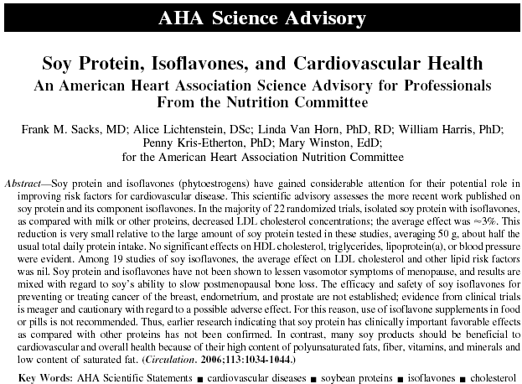
Controversy regarding efficacy of Soy Protein

Slide 16
Lifestyle Heart Trial
41 male and female CHD patients
Randomized to <10% fat diet, exercise and meditation (Rx group) vs. Step 1 diet
At one year 37% LDL-C reduction, 22% weight loss, and 1.8 % regression in Rx group vs 2.3% progression in control group (quantitative coronary angiography)
At 5 years 20% LDL-C reduction, 3.1% regression in Rx group vs 11.8% progression in control group (n=35)
Ornish et al. Lancet 1990; 336:129-133, and JAMA 1998; 280:2001-2007.

Slide 17
Dietary Approaches: Zone/Soy Zone
Premise is to reduce insulin levels and stabilize glucose control by limiting starchy carbohydrates, emphasize low-density carbohydrates.
Emphasis on protein (avg. 75g/day for women and 100 g/day for men) (one-third of plate) (soy protein products for Soy Zone) and carbohydrates (primarily from vegetables, fruits to a lesser extent). Allows limited monounsaturated fats.
Metaanalysis of clinical trial on soy protein (avg. 47g/day) showed reduction in total cholesterol of 9%, LDL-C 13%, and triglycerides 11% (NEJM 1995; 333: 276-82)

Slide 18
Dietary Approaches: Atkins
Intended to correct unbalanced metabolism by restriction of carbohydrates to reduce insulin production and conversion of excess carbohydrates into stored body fat
Induction diet limits carbohydrate intake to 20 gms/day (e.g., 3 cups of salad veg or 2 cups salad + 2/3 cup cooked vegs) to induce ketosis/ lypolysis. Maintenance diet 25-30 gms/day.
Pure proteins, fats, and protein/fat allowed (all meats, fish, foul, eggs, cheese, veg oils, butter)
Most carbohydrates are not allowed--fruits, bread, grains, starchy vegs, or dairy products.

Slide 19
Data on Atkins and Zone diets
Medline analysis 2001
No large scale (>50 subjects) long term (>6months) follow-up studies could be identified with weight loss, cardiovascular risk assessment or clinical outcome data

Slide 20
Pritikin Lifestyle Program
3-week residential program with exercise and ad libitum low fat (<10% of calories) plant based diet
4566 men and woman
Mean LDL-C reduction 25% in men and 20% in woman
Significant reductions in TG and HDL-C
Significant 3.2% reduction in body weight
Limited long-term follow up
Barnard et al. Arch Intern Med 1991;151:1389-1394.

Slide 21
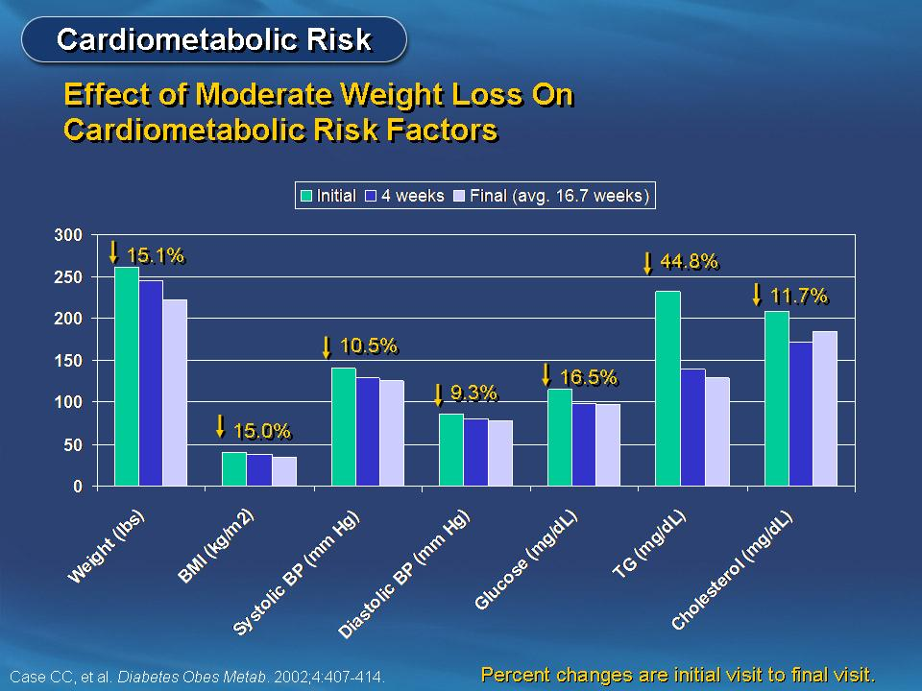
Notes:
It has become well accepted that moderate weight loss improves cardiovascular and metabolic risk factors. In a study by Case and colleagues of obese individuals enrolled in a medically supervised rapid weight loss program study, 1 year of consecutive patients’ charts was reviewed to determine the response to diet-induced weight loss. Out of 185 individuals, 125 (68%) met the NCEP definition of the metabolic syndrome.
At 4 weeks, a moderate decrease in weight (6.5%) induced by a very low calorie diet resulted in substantial reductions of systolic (11.1 mm Hg) and diastolic (5.8 mm Hg) blood pressure, glucose (17 mg/dL), triglycerides (94 mg/dL) and total cholesterol (37 mg/dL) (all P<0.001). These improvements were sustained at the end of active weight loss (average 16.7 weeks; total weight loss 15.1%), with further significant reductions in blood pressure and triglycerides. Weight loss was related to the changes in each criterion of the metabolic syndrome.
The authors concluded that moderate weight loss markedly improved all aspects of the metabolic syndrome.
Case CC, Jones PH, Nelson K, O’Brian Smith E, Ballantyne CM. Impact of weight loss on the metabolic syndrome. Diabetes Obes Metab. 2002;4:407-414.

Slide 22
Diet Evidence:
Types of Treatment Programs
Very low fat
  Ornish (Reversal diet and Prevention diet)
    Vegetarian with 10% calories from fat. No cooking oils, avocados, nuts, and seeds. High fiber. No caloric restriction.
  Pritikin
    Very low-fat (primarily vegetarian) diet based on whole grains, fruits, and vegetables
Intermediate
  Sugar Busters
    30% protein, 40% fat, 30% carbohydrates (low glycemic index)
  Zone
    30% protein, 30% fat, 40% carbohydrates
Notes:
22
With rising rates of obesity, there is an increased interest in weight loss. Several diet programs have been developed, with varying dietary content.

Slide 23
Diet Evidence:
Types of Treatment Programs (Continued)
Very low carbohydrate
  Atkins (Induction and Maintenance)
    1st 2 weeks (<20 grams of carbohydrates/day with no high glycemic foods).
    Then can add 5 grams of carbohydrates/day each week to maximum of 90 grams of carbohydrates/day long term.
  South Beach (3 Phases)
    1st phase (2 weeks) significantly restricts carbohydrates
    2nd phase reintroduces low glycemic carbohydrates
    3rd phase attempts to maintain weight
Caloric restriction
  Weight watchers
    Assigns foods a point value and restricts the number of points that can be consumed/day.
Notes:
23
With rising rates of obesity, there is an increased interest in weight loss. Several diet programs have been developed, with varying dietary content.

Slide 24
Diet Evidence:
Primary Prevention
160 overweight and obese patients randomized to the Atkins, Zone, Weight Watchers, or Ornish diets for 1 year
Weight loss is similar among diet programs, but hard to sustain because of poor long-term compliance
Ornish
20/40*
Weight Watchers
26/40*
Zone
26/40*
Atkins
21/40*
0
3
6
9
Wt loss (lbs)
*Ratio of individuals completing the study to those enrolled
Dansinger, ML et al. JAMA 2005;293:43-53
Notes:
24
Diet program adherence remains a significant hurdle to sustain weight loss with a >50% drop out rate, regardless of the weight loss program studied.

Slide 25
Lifestyle Heart Trial
41 male and female CHD patients
Randomized to <10% fat diet, exercise and meditation (Rx group) vs. Step 1 diet
At one year 37% LDL-C reduction, 22% weight loss, and 1.8 % regression in Rx group vs 2.3% progression in control group (quantitative coronary angiography)
At 5 years 20% LDL-C reduction, 3.1% regression in Rx group vs 11.8% progression in control group (n=35)
Ornish et al. Lancet 1990; 336:129-133, and JAMA 1998; 280:2001-2007.

Slide 26
Diet Evidence:
Effect on Lipid Parameters and CRP
46 dyslipidemic patients randomized to a low fat diet, a low fat diet and lovastatin (20 mg), or a dietary portfolio* for 4 weeks
A diversified diet improves lipid parameters and CRP levels
30
LDL-C
LDL-C:HDL-C
CRP
20
10
Low fat diet
0
Change from Baseline (%)
Statin
-10
-20
Dietary portfolio*
-30
-40
-50
0
2
4
0
2
4
0
2
4
Weeks
Weeks
Weeks
*Enriched in plant sterols, soy protein, viscous fiber, and almonds
Jenkins DJ et al. JAMA 2003;290:502-10
Notes:
26
This trial randomized 46 healthy hyperlipidemic adults to one of three interventions for one month: (a) a low-fat diet, (b) a low-fat diet plus lovastatin (20 mg daily), or (c) a dietary portfolio high in almonds, plant sterols, soy protein, and viscous fibers.
The low-fat diet, low-fat diet + statin, and dietary portfolio groups had mean reductions in C-reactive protein of 10.0% (p=0.27), 33.3% (p=0.002) and 28.2% (p=0.02), respectively. The reductions in levels of LDL-C were 8.0% (p=0.002), 30.9% (p<0.001) and 28.6% (p<0.001), respectively. The CRP and LDL-C levels were significantly reduced in the dietary portfolio and low-fat diet + statin groups as compared to the low-fat diet alone group. There were no significant reductions in CRP and LDL-C levels in the low-fat diet + statin group as compared to the dietary portfolio group.

Slide 27
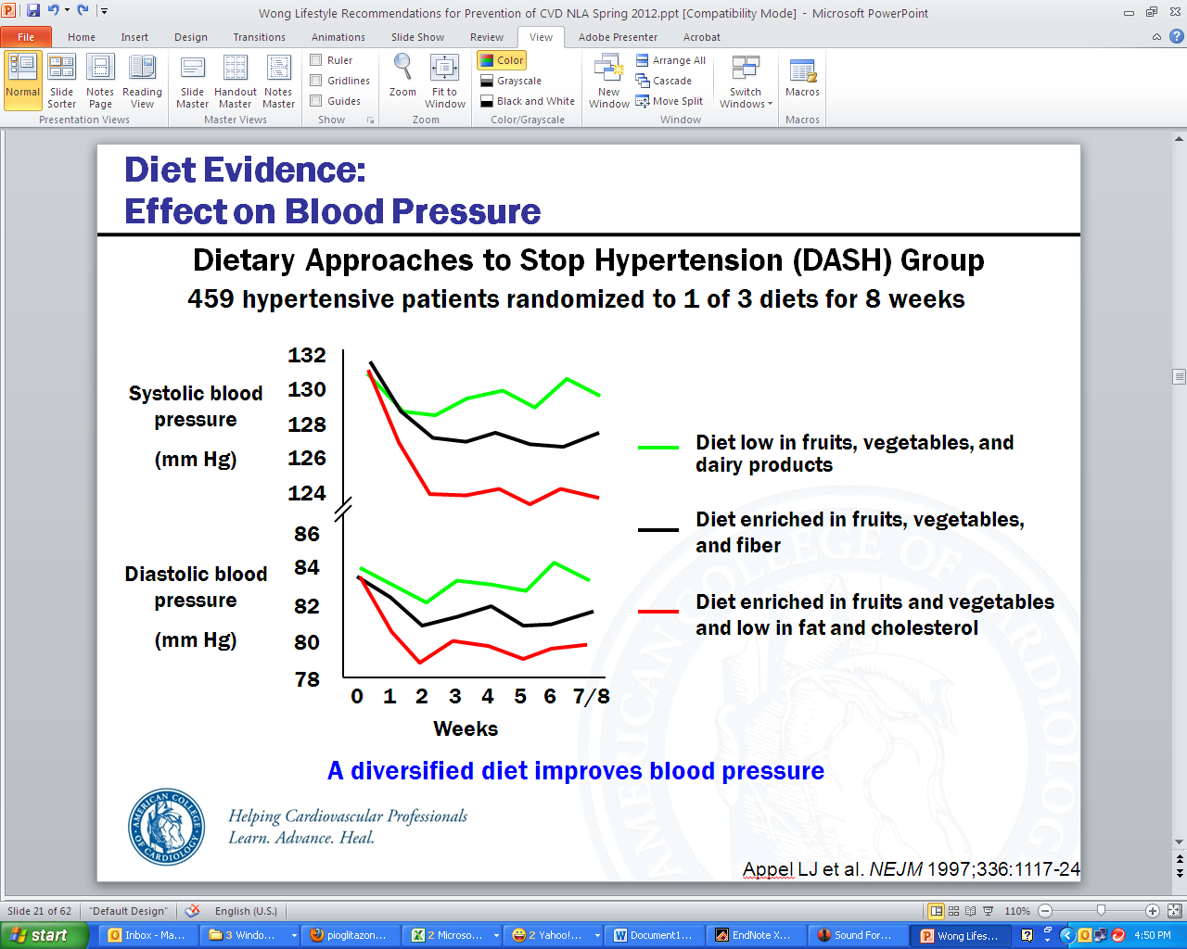
Diet Evidence:
Effect on Blood Pressure
Dietary Approaches to Stop Hypertension (DASH) Group
459 hypertensive patients randomized to 1 of 3 diets for 8 weeks
Systolic blood pressure
(mm Hg)
Diastolic blood pressure
(mm Hg)
A diversified diet improves blood pressure
Appel LJ et al. NEJM 1997;336:1117-24
Notes:
27
The Dietary Approaches to Stop Hypertension (DASH) trial randomized 459 adults with systolic blood pressures <160 mmHg and diastolic blood pressures between 80-95 mmHg to a control diet, a diet enriched in fruits and vegetables, or a combination diet that was enriched in fruits and vegetables and low in fat and cholesterol. The sodium content did not differ across the three diets.
Compared to the control diet, the fruits and vegetables diet decreased systolic and diastolic blood pressure by 2.8 mmHg and 1.1 mmHg, respectively (P<0.001 for systolic, p=0.07 for diastolic). Compared to the control diet, the combination diet decreased systolic and diastolic blood pressure by 5.5 mmHg and 3.0 mmHg, respectively (P<0.001 for each).

Slide 28
Pre-diabetic Conditions:
Benefit of Lifestyle Modification
Diabetes Prevention Program (DPP)
3,234 patients with elevated fasting and post-load glucose levels randomized to placebo, metformin (850 mg bid), or lifestyle modification* for 3 years
Lifestyle modification reduces the risk of developing DM
Placebo
Metformin
Lifestyle modification
40
30
20
Incidence of DM (%)
10
0
0
1
2
3
4
0
Years
*Includes 7% weight loss and at least 150 minutes of physical activity per week
Knowler WC et al. NEJM 2002;346:393-403.
Notes:
28
The Diabetes Prevention Program randomized 3,234 patients with elevated fasting and post-load glucose levels to lifestyle modification, metformin (850 mg twice daily), or placebo for 3 years. Patients randomized to weight loss and physical activity (averaged to 22 minutes/day) had the lowest incidence of new onset diabetes mellitus and highlight the importance of structured lifestyle modification in at-risk individuals.

Slide 29
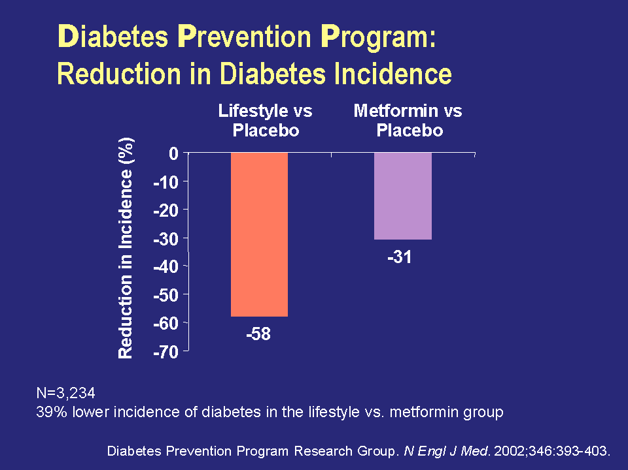
Diabetes Prevention Program:
Reduction in Diabetes Incidence
Notes:
Lifestyle reduced the incidence of diabetes by 58% (95% CI, 48%-66%) and metformin reduced the incidence by 31% (95% CI, 17%-43%).
The incidence of diabetes was 39% lower (95% CI, 24%-51%) in the lifestyle group than in the metformin group.
Treatment effects did not differ significantly according to sex or to race or ethnic group.
The lifestyle intervention was highly effective in all subgroups. Its effect was significantly greater among persons with lower base-line glucose concentrations two hours after a glucose load than among those with higher base-line glucose values.
The advantage of lifestyle intervention over metformin was greater in older persons and those with a lower body-mass-index than in younger persons and those with a higher body-mass-index.
The effect of metformin was less with a lower body-mass-index or a lower fasting glucose concentration than with higher values for those variables.
The investigators concluded that, compared with placebo, 1 case of diabetes can be prevented for every 7 persons treated with lifestyle changes for 3 years and for every 14 persons treated with metformin for
3 years.
Diabetes Prevention Program Research Group. N Engl J Med. 2002;346:393-403.

Slide 30
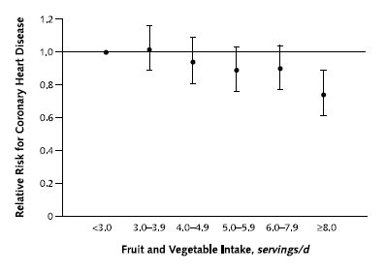
Diet Evidence:
Benefits of Fruits and Vegetables
Nurses’ Health Study and Health Professional’s Follow-up Study
126,399 persons followed for 8-14 years to assess the relationship between fruit and vegetable intake and adverse CV outcomes*
Increased fruit and vegetable intake reduces CV risk
*Includes nonfatal MI and fatal coronary heart disease
CV=Cardiovascular, MI=Myocardial infarction
Joshipura KJ, et al. 2001 Ann Intern Med134:1106-14
Notes:
30
The Nurses’ Health Study included 84,251 women between the ages of 34 to 59 years that were followed for 14 years. The Health Professional’s Follow-Up Study included 42,148 men between the ages of 40 to 75 years that were followed for 8 years. In these cohorts, each additional daily serving of fruits and vegetables was associated with a 4% lower risk of coronary heart disease (RR 0.96 [CI, 0.94 to 0.99]; P = 0.01). Men and women in the highest quintile of fruit and vegetable intake had a lower risk of coronary heart disease (RR 0.80 [95% CI, 0.69 to 0.93]) compared with those in the lowest quintile of intake.

Slide 31
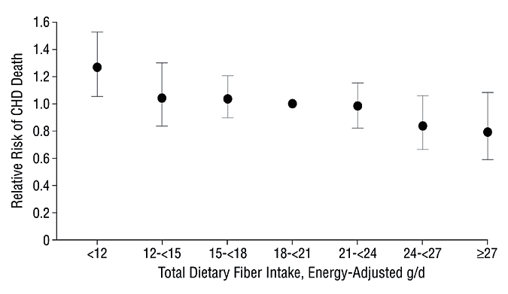
Diet Evidence:
Benefits of Whole Grains and Fiber
336,244 persons followed for 6-10 years to assess the relationship between dietary fiber intake and adverse CV outcomes
Increased dietary fiber intake reduces CV risk
RR=0.73, P<0.001
CV=Cardiovascular, CHD=Coronary heart disease
Pereira MA et al. Arch Int Med 2004;164:370-76
Notes:
31
A meta-analysis of 336,244 persons in 10 prospective cohort studies with 6-10 years of follow-up evaluated the association between dietary fiber intake and risk of coronary heart disease. Each additional 10 grams of daily fiber intake was associated with a 14% relative reduction in risk of coronary events (relative risk [RR], 0.86; 95% confidence interval [CI], 0.78-0.96) and a 27% relative reduction in risk of coronary death (RR, 0.73; 95% CI, 0.61-0.87).

Slide 32
Diet Evidence:
Primary Prevention
22,043 adults evaluated for adherence to a Mediterranean diet, with points given for high consumption of vegetables, legumes, fruits, nuts, cereal, and fish and points subtracted for high consumption of meat, poultry, and dairy
High adherence to a Mediterranean diet is associated with a reduction in death
Variable | # of Deaths/ # of Participants | Fully Adjusted Hazard Ratio (95% CI)
Death from any cause | 275/22,043 | 0.75 (0.64-0.87)
Death from CHD | 54/22,043 | 0.67 (0.47-0.94)
Death from cancer | 97/22,043 | 0.76 (0.59-0.98)
Trichopoulou A, et al. NEJM 2003;348:2595-6
Notes:
32
In this study, 22,043 Greek adults were evaluated for adherence to a Mediterranean diet. Points were given for high vegetables, legumes, fruits & nuts, cereal, fish and subtracted for high intakes of meat, poultry, and dairy to comprise a 10 point Mediterranean diet adherence score. During a median follow up of 44 months, a 2 point increment on the Mediterranean adherence score was associated with a significant survival benefit after adjustment for 10 other traditional cardiovascular risk factors (HR 0.75, CI 0.64-0.87). This association was even larger for coronary heart disease mortality (HR 0.67, CI 0.47-0.94).

Slide 33
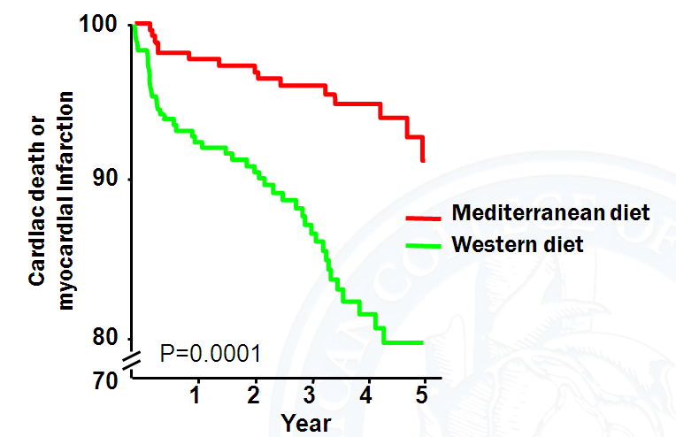
Diet Evidence:
Secondary Prevention
Lyon Diet Heart Study
605 patients following a MI randomized to a Mediterranean* or Western** diet for 4 years
A Mediterranean diet reduces cardiovascular events
*High in polyunsaturated fat and fiber,
**High in saturated fat and low in fiber
De Lorgeril M et al. Circulation 1999;99:779-785
Notes:
33
The Lyon Diet Heart Study sought to determine whether a Mediterranean diet could reduce the risk of cardiovascular events following a myocardial infarction. The study randomized 605 patients to a Mediterranean diet high in polyunsaturated fat and fiber or a Western diet high in saturated fat and low in fiber. Three composite outcomes were studied: (a) cardiac death and nonfatal myocardial infarction, (b) cardiac death, nonfatal MI, and major secondary end points (unstable angina, stroke, heart failure, pulmonary or peripheral embolism, and (c) cardiac death, nonfatal MI, major secondary end points, and minor events requiring hospital admission.
All three composite outcomes were significantly reduced in the Mediterranean diet group. This slide shows cumulative survival without MI among control and experimental (Mediterranean group) subjects.

Slide 34

ω-3 Fatty Acids Evidence:
Primary and Secondary Prevention
Japan Eicosapentaenoic acid Lipid Intervention Study (JELIS)
18,645 patients with hypercholesterolemia randomized to EPA (1800 mg) with a statin or a statin alone for 5 years
ω-3 fatty acids provide CV benefit, particularly in secondary prevention
Years
CV=Cardiovascular, EPA=Eicosapentaenoic acid
*Composite of cardiac death, myocardial infarction, angina, PCI, or CABG
Yokoyama M et al. Lancet. 2007;369:1090-8
Notes:
34
The JELIS trial randomized 18,645 hypercholesterolemic patients in Japan to receive either 1800 mg of EPA daily with a statin (EPA group; n=9326) vs. a statin alone (controls; n=9319). After a 5-year follow-up, the primary endpoint of any major coronary event was reduced from 3.5% in the statin alone group to 2.8% in the EPA + statin group (RRR 19% p=0.011). In patients with no history of coronary artery disease, EPA treatment reduced major coronary events by 18%, but this finding was not significant (1.4% in the EPA group vs 1.7% in the control group; p=0.132).

Slide 35
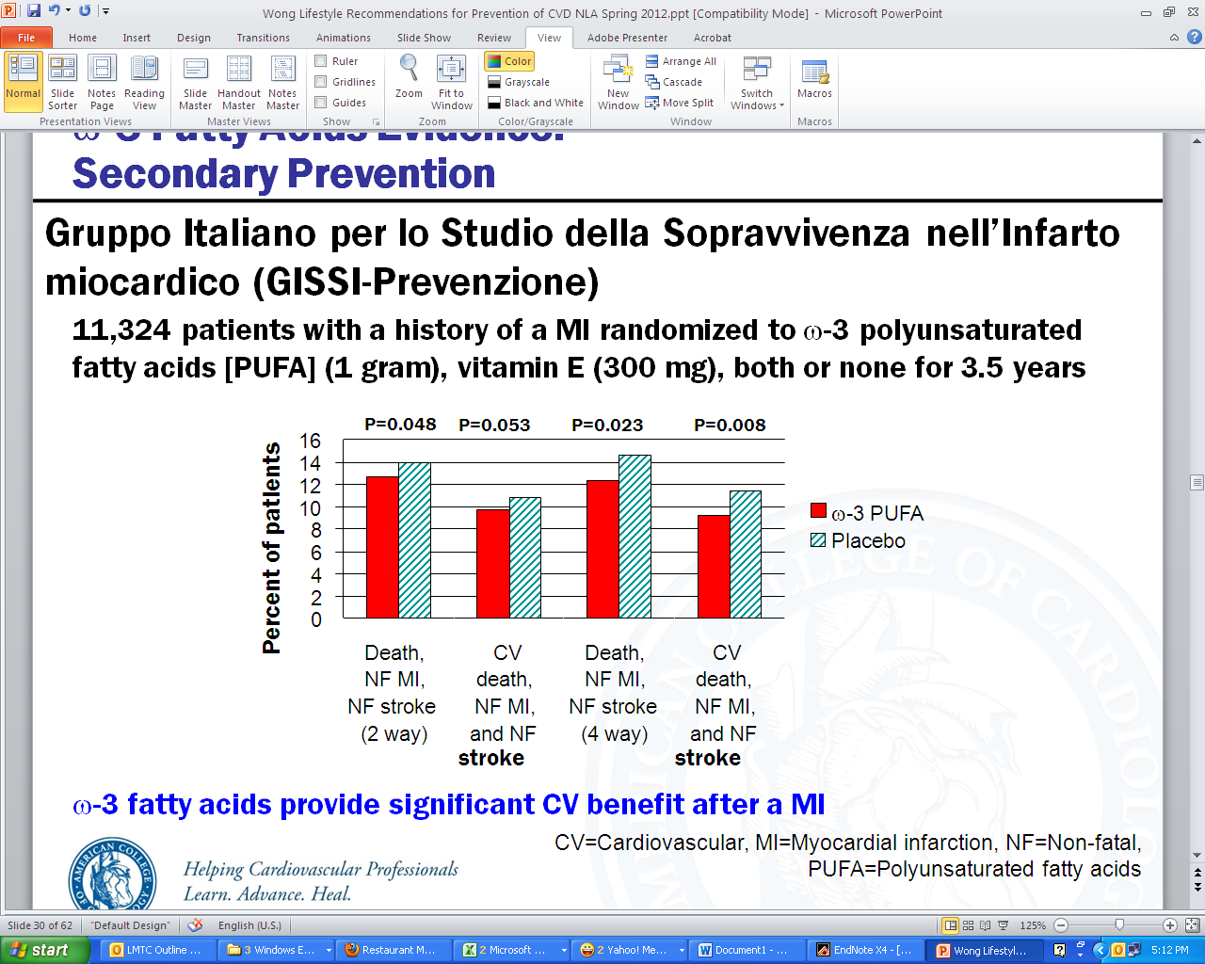
ω-3 Fatty Acids Evidence:
Secondary Prevention
Gruppo Italiano per lo Studio della Sopravvivenza nell’Infarto miocardico (GISSI-Prevenzione)
11,324 patients with a history of a MI randomized to ω-3 polyunsaturated fatty acids [PUFA] (1 gram), vitamin E (300 mg), both or none for 3.5 years
ω-3 fatty acids provide significant CV benefit after a MI
CV=Cardiovascular, MI=Myocardial infarction, NF=Non-fatal, PUFA=Polyunsaturated fatty acids
GISSI Investigators. Lancet 1999;354:447-455
Notes:
The GISSI trial randomized 11,324 patients with a history of MI to n-3 polyunsaturated fatty acids (PUFA) (1 gram daily), vitamin E (300 mg daily), both, or none for 3.5 years. Patients treated with n-3 PUFA, but not vitamin E, had a significantly lowered risk of the primary end point (a composite of death, nonfatal MI, and stroke). Treatment with n-3 PUFA decreased the relative risk of one primary end point by 10% in a two-way analysis (p=0.048) and 15% in a four-way analysis (p=0.023). Of note, the dose of n-3 PUFA used in this study (1 gram daily) is the dose recommended for patients with coronary heart disease, but is lower than the dose approved for triglyceride lowering (2-4 gram daily).
35

Slide 36
N-3 Fatty Acid Recommendation
American Dietetic Association 2007
For those without heart disease
Two 3.5 oz svgs/wk of fatty fish are assoc with 30-40% reduced risk of death from cardiac events.
Grade II Fair
Notes:
36
Fair equals not strong randomized controlled clinical trials.

Slide 37
N-3 Fatty Acids
American Dietetic Association 2007
For those with heart disease
Approx 1g/d of DHA & EPA from fatty fish OR supplement decreases the risk of death from cardiac events.
Grade II Fair

Slide 38
N-3 Fatty Acid Recommendation
American Dietetic Association 2007
Consume both marine & plant sources .
Fatty fish: two 3.5 oz serving/wk (salmon, herring, sardines)
or
1.5 g ALA/day eg 1 TBS canola, 1/2 TBS ground flax seeds.

Slide 39
2013 AHA/ACC Guideline on
Lifestyle Management to Reduce Cardiovascular Risk
Endorsed by the American Association of Cardiovascular and Pulmonary Rehabilitation, American Pharmacists Association, American Society for Nutrition, American Society for Preventive Cardiology, American Society of Hypertension, Association of Black Cardiologists, National Lipid Association, Preventive Cardiovascular Nurses Association, and WomenHeart: The National Coalition for Women with Heart Disease
© American College of Cardiology Foundation and American Heart Association, Inc.

Slide 40


Charge of Lifestyle Work Group
Lifestyle Recommendations
Evidence Review on Diet and Physical Activity (in the absence of weight loss) to be integrated with the recommendations of the Blood Cholesterol and High Blood Pressure Panels

Slide 41
Lifestyle Workgroup Critical Questions
CQ1 | Among adults*, what is the effect of dietary patterns and/or macronutrient composition on CVD risk factors, when compared to no treatment or to other types of interventions?
CQ2 | Among adults, what is the effect of dietary intake of sodium and potassium on CVD risk factors and outcomes, when compared with no treatment or with other types of interventions?
CQ3 | Among adults, what is the effect of physical activity on blood pressure and lipids when compared with no treatment, or with other types of interventions?
*Those ≥18 years of age and <80 years of age.

Slide 42

Lifestyle Topics: Dietary Patterns
Mediterranean Diet
  BP and lipids
DASH and DASH variations
  BP and lipids,
  and in subpopulations
High- vs. Low-Glycemic Diets
  BP and lipids

Slide 43

Mediterranean-Style Dietary Pattern Evidence Yield
3 RCTs conducted in free-living populations and 1 prospective cohort study that met criteria for inclusion on strategies for CVD risk factor reduction using the Mediterranean-style dietary pattern.

Slide 44
Mediterranean-Style Dietary Pattern Description
There is no uniform definition of the Mediterranean-style dietary pattern diet in the randomized trials and cohort studies examined.
The most common features in these studies were diets that were:
  high in fruits (particularly fresh) and vegetables (emphasizing root and green varieties)
  high in whole grains (cereals, breads, rice, or pasta)
  fatty fish (rich in omega–3 fatty acids)
  low in red meat (and emphasizing lean meats); substituted lower-fat or fat-free dairy products for higher-fat dairy foods

Slide 45
Mediterranean-Style Dietary Pattern Description (cont.)
    used oils (olive or canola), nuts (walnuts, almonds, or hazelnuts), or margarines blended with rapeseed or flaxseed oils in lieu of butter and other fats
The Mediterranean-style dietary patterns examined tended to be:
  moderate in total fat (32%–35% of total calories)
  relatively low in saturated fat (9%–10% of total calories)
  high in fiber (27–37g/day)
  high in PUFA
    particularly omega–3s

Slide 46
Mediterranean Diet and BP
Counseling to eat a Mediterranean-style dietary pattern compared to minimal advice to consume a low-fat dietary pattern, in free-living middle-aged or older adults (with type 2 diabetes mellitus or at least 3 CVD risk factors):
↓BP by 6–7/2–3 mm Hg
In an observational study of healthy younger adults, adherence to a Mediterranean-style dietary pattern was associated with:
↓BP 2–3/1–2 mm Hg
Strength of Evidence: Low

Slide 47
Mediterranean Diet and Lipids
Counseling to eat a Mediterranean-style dietary pattern compared with minimal or no dietary advice, in free-living middle-aged or older adults (with or without CVD or at high risk for CVD) resulted in no consistent effect on plasma LDL-C, HDL-C, and TG; in part because of substantial differences and limitations in the studies.
Strength of Evidence: Low

Slide 48

DASH: Dietary Approaches to Stop Hypertension
2 RCTs (6 citations) evaluating the DASH pattern met eligibility criteria.
DASH dietary pattern description:
  high in vegetables, fruits, and low-fat dairy products
  high in whole grains, poultry, fish, and nuts
  low in sweets, sugar-sweetened beverages, and red meats
  low in saturated fat, total fat, and
  cholesterol
  high in potassium, magnesium,
  calcium
  rich in protein and fiber

Slide 49

DASH and BP
When all food was supplied to adults with BP 120–159/80–95 mm Hg and both body weight and sodium intake were kept stable, the DASH dietary pattern, compared with a typical American diet of the 1990s:
↓BP 5–6/3 mm Hg
Strength of Evidence: High

Slide 50

DASH and Lipids
When food was supplied to adults with a total cholesterol level <260 mg/dL and LDL-C level <160 mg/dL and body weight was kept stable, the DASH dietary pattern, compared with a typical American diet of the 1990s:
↓LDL-C by 11 mg/dL
↓HDL-C by 4 mg/dL
    • no effect on TG
Strength of Evidence: High

Slide 51
DASH Subpopulations and BP
When all food was supplied to adults with BP 120–159/80–95 mm Hg and body weight was kept stable, the DASH dietary pattern, compared with the typical American diet of the 1990s, ↓ BP in:
  women and men
  African-American and non–African-American adults
  older and younger adults
  hypertensive and nonhypertensive adults
Strength of Evidence: High

Slide 52
DASH Subpopulations, BP, and Lipids
In patients who would benefit from ↓ in BP and lipids, the DASH dietary pattern, when compared with the typical American diet of the 1990s, ↓ BP and ↓ LDL-C similarly in:
  women and men
  African-Americans and non–African-American adults
  older and younger adults
  hypertensive and nonhypertensive adults
Strength of Evidence: High

Slide 53
DASH Subpopulations, Lipids
When all food was supplied to adults with a total cholesterol level <260 mg/dL, LDL-C level <160 mg/dL, and body weight was kept stable, the DASH dietary pattern, as compared to a typical American diet of the 1990s, ↓ LDL-C and ↓ HDL-C similarly in subgroups: African-American and non–African-American adults, and hypertensive and nonhypertensive adults.
Strength of Evidence: Low

Slide 54
DASH Variations (OMNIHeart Trial)
1 RCT met eligibility criteria for DASH eating pattern variations
In OmniHeart, 2 variations of the DASH dietary pattern were compared to DASH:
  1 which replaced 10% of total daily energy from carbohydrates with protein
  the other which replaced the same amount of carbohydrates with unsaturated fat

Slide 55
DASH Variation Evidence
BP
In adults with BP of 120–159/80–95 mm Hg, modifying the DASH dietary pattern by replacing 10% of calories from carbohydrates with the same amount of either protein or unsaturated fat (8% MUFA and 2% PUFA) lowered systolic BP by 1 mm Hg compared to the DASH dietary pattern.
Among adults with BP 140–159/90–95 mm Hg, these replacements lowered systolic BP by 3 mm Hg relative to DASH.
Strength of Evidence: Moderate

Slide 56
DASH Variation Evidence (cont.)
Lipids
In adults with average baseline LDL-C 130 mg/dL, HDL-C 50 mg/dL, and TG 100 mg/dL, modifying the DASH dietary pattern by replacing 10% of calories from carbohydrates with 10% of calories from protein
↓ LDL-C by 3 mg/dL
↓ HDL-C by 1 mg/dL
↓ TG by 16 mg/dL compared to the DASH
dietary pattern

Slide 57
DASH Variation Evidence (cont.)
Replacing 10% of calories from carbohydrates with 10% of calories from unsaturated fat (8% MUFA and 2% PUFA)
↓ LDL-C similarly
↑ HDL-C by 1 mg/dL
↓ TG by 10 mg/dL compared to the DASH
dietary pattern
Strength of Evidence: Moderate

Slide 58

Glycemic Index/Load Dietary Approaches
3 RCTs evaluating glycemic index met eligibility criteria.
There is insufficient evidence to determine whether low-glycemic diets vs. high-glycemic diets affect lipids or BP for adults without diabetes mellitus.
The evidence for this relationship in adults with diabetes mellitus was not reviewed.

Slide 59
Lifestyle Topics: Dietary Fat and Cholesterol
Saturated Fat - Lipids
Replacement of SFA with carbohydrates, MUFA, or PUFA - Lipids
Replacement of carbohydrates with MUFA or PUFA - Lipids
Replacement of trans fatty acids with carbohydrates, MUFA, or PUFA, SFA - Lipids
Dietary Cholesterol - Lipids

Slide 60

Dietary Fat and Cholesterol
3 trials evaluating saturated, trans fat, and dietary cholesterol.
In addition a search was conducted for meta-analyses and systematic reviews from 1990 to 2009.
  4 systematic reviews and meta-analyses met inclusion criteria.

Slide 61
Saturated Fat
Food supplied to adults in a dietary pattern that achieved a macronutrient composition of 5%–6% saturated fat, 26%–27% total fat, 15%–18% protein, and 55%–59% carbohydrates compared to the control diet (14%–15% saturated fat, 34%–38% total fat, 13%–15% protein, and 48%–51% carbohydrates):
↓ LDL-C 11–13 mg/dL in 2 studies
↓ LDL-C 11% in another study.
Strength of Evidence: High
Note: Saturated fat was not an isolated change.

Slide 62
Saturated Fat (cont.)
In controlled feeding trials among adults, for every 1% of energy from SF) that is replaced by 1% of energy from carbohydrates, MUFA, or PUFA:
  LDL-C is lowered by an estimated 1.2, 1.3, and 1.8 mg/dL, respectively
  HDL-C is lowered by an estimated 0.4, 1.2, and 0.2 mg/dL, respectively
For every 1% of energy from SFA that is replaced by 1% of energy from:
  Carbohydrates and MUFA
    TG are raised by an estimated 1.9 and 0.2 mg/dL, respectively.
  PUFA
    TG are lowered by an estimated 0.4 mg/dL.
Strength of Evidence: Moderate

Slide 63
Effect of Substitution of 1% Energy of Saturated Fat
 | Carbohydrates, MUFA | MUFA | PUFA
LDL-C (mg/dL) | ↓1.2 | ↓1.3 | ↓1.8
HDL-C (mg/dL) | ↓0.4 | ↓1.2 | ↓0.2
TG (mg/dL) | ↑1.9 | ↑0.2 | ↓0.4

Slide 64
Substitution of Fatty Acids for Carbohydrates
In controlled feeding trials among adults, for every 1% of energy from carbohydrates that is replaced by 1% of energy from:
  MUFA
    LDL-C is lowered by 0.3 mg/dL, HDL-C is raised by 0.3 mg/dL, and TG are lowered by 1.7 mg/dL
  PUFA
    LDL-C is lowered by 0.7 mg/dL, HDL-C is raised by 0.2 mg/dL, and TG are lowered by 2.3 mg/dL
Strength of Evidence: Moderate

Slide 65

Trans Fat
In controlled feeding trials among adults, for every 1% of energy from trans MUFA replaced with 1% of energy from:
  MUFA or PUFA
    ↓ LDL-C by 1.5 and 2.0 mg/dL, respectively.
  SFA, MUFA, or PUFA
    ↑ HDL-C by 0.5, 0.4 and 0.5 mg/dL, respectively.
  MUFA or PUFA
    ↓ TG by 1.2 and 1.3 mg/dL.
Strength of Evidence: Moderate

Slide 66

Trans Fat (cont.)
In controlled feeding trials among adults, the replacement of 1% energy as trans MUFA with carbohydrates decreased LDL-C cholesterol levels by 1.5 mg/dL, and had no effect on HDL-C cholesterol and TG levels.
Strength of Evidence: Moderate

Slide 67

Dietary Cholesterol
There is insufficient evidence to determine whether lowering dietary cholesterol reduces LDL-C.

Slide 68
Lifestyle Topics: Sodium
BP:
  Sodium Reduction - BP
  Sodium Levels/ - BP and subpopulations
  Sodium Reduction + DASH - BP
  Sodium/ Other Minerals - BP
CVD Outcomes:
  Sodium Reduction - CVD events
  Sodium Intake - Stroke, CVD Risk
  Sodium Intake - HF

Slide 69

Sodium and BP: Overall Results
In adults aged 25–80 years with BP 120–159/80–95 mm Hg, reducing sodium intake lowers BP.
Strength of Evidence: High

Slide 70
Different Levels of Sodium Intake
In adults aged 25–75 years with BP 120–159/80–95 mm Hg, relative to approximately 3,300 mg/day ↓ sodium intake that achieved a mean 24-hour urinary sodium excretion of approximately 2,400 mg/day:
↓ BP by 2/1 mm Hg
↓ Sodium intake that achieved a mean
24-hour urinary sodium excretion of
approximately 1,500 mg/day
↓ BP by 7/3 mm Hg
Strength of Evidence: Moderate

Slide 71
Different Levels of Sodium Intake (cont.)
In adults aged 30–80 with or without hypertension, counseling to ↓ sodium intake by an average of 1,150 mg per day:
↓ BP by 3–4/1–2 mm Hg
Strength of Evidence: Moderate

Slide 72
Sodium and BP in Subpopulations
In adults with prehypertension or hypertension, reducing sodium intake lowers BP in women and men; African-American and non–African-American adults; and older and younger adults.
Strength of Evidence: High

Slide 73
Sodium and BP in
Subpopulations (cont.)
Reducing sodium intake lowers BP in adults with either prehypertension or hypertension when eating either the typical American diet or the DASH dietary pattern. The effect is greater in those with hypertension.
Strength of Evidence: High

Slide 74
Sodium and Dietary Pattern Changes
In adults aged 25–80 with BP 120–159/80–95 mm Hg, the combination of ↓ sodium intake + eating the DASH dietary pattern lowers BP more than ↓ sodium intake alone.
Strength of Evidence: Moderate
There is insufficient evidence from RCTs to determine whether ↓ sodium intake + changing dietary intake of any other single mineral (for example, increasing potassium, calcium, or magnesium) ↓ BP more than ↓ sodium intake alone.

Slide 75
Sodium and CHD/CVD Outcomes
A ↓ in sodium intake of ~1,000 mg/day ↓ CVD events by ~30%.
Strength of Evidence: Low
Higher dietary sodium intake is associated with a greater risk of fatal and nonfatal stroke and CVD.
Strength of Evidence: Low

Slide 76
Sodium and CHD/CVD
Outcomes (cont.)
There is insufficient evidence to determine the association between sodium intake and the development of CHF.
There is insufficient evidence to assess the effect of ↓ dietary sodium intake on CVD outcomes in patients with existing CHF.

Slide 77
Lifestyle Topics: Potassium
Potassium intake – BP
Potassium intake – Stroke Risk
Potassium intake – CHD/ CHF/ CVD mortality

Slide 78
Potassium and BP and CVD Outcomes
There is insufficient evidence to determine whether ↑ dietary potassium intake ↓ BP.
In observational studies with appropriate adjustments (BP, sodium intake, etc.), higher dietary potassium intake is associated with ↓ stroke risk.
Strength of Evidence: Low

Slide 79
Potassium and BP and CVD
Outcomes (cont.)
There is insufficient evidence to determine whether there is an association between dietary potassium intake and CHD, CHF, and CVD mortality.

Slide 80
What’s New in Lifestyle?
Recommendations based on in-depth systematic reviews. Previous reports used different methods and structure. More depth, less breadth.
More emphasis on dietary patterns
More data provided to support
  saturated and trans fat restriction
  dietary salt restriction
Evidence to support dietary cholesterol restriction in those who could benefit from ↓ LDL-C is inadequate.

Slide 81
LDL-C: Advise adults who would benefit from LDL-C lowering* to:
I
IIa
IIb
III
Consume a dietary pattern that emphasizes intake of vegetables, fruits, and whole grains; includes low-fat dairy products, poultry, fish, legumes, nontropical vegetable oils and nuts; and limits intake of sweets, sugar-sweetened beverages, and red meats.
  Adapt this dietary pattern to appropriate calorie requirements, personal and cultural food preferences, and nutrition therapy for other medical conditions (including diabetes).
  Achieve this pattern by following plans such as the DASH dietary pattern, the U.S. Department of Agriculture (USDA) Food Pattern, or the AHA Diet.
A
*Refer to 2013 Blood Cholesterol Guideline for guidance on who would benefit from LDL-C lowering.

Slide 82
LDL-C: Advise adults who would benefit from LDL-C lowering* to: (cont.)
Aim for a dietary pattern that achieves 5% to 6% of calories from saturated fat.
Reduce percent of calories from saturated fat.
Reduce percent of calories from trans fat.
I
IIa
IIb
III
A
I
IIa
IIb
III
A
I
IIa
IIb
III
A
*Refer to 2013 Blood Cholesterol Guideline for guidance on who would benefit from LDL-C lowering.

Slide 83
BP: Advise adults who would benefit from BP lowering to:
I
IIa
IIb
III
Consume a dietary pattern that emphasizes intake of vegetables, fruits, and whole grains; includes low-fat dairy products, poultry, fish, legumes, nontropical vegetable oils and nuts; and limits intake of sweets, sugar-sweetened beverages, and red meats.
Adapt this dietary pattern to appropriate calorie requirements, personal and cultural food preferences, and nutrition therapy for other medical conditions (including diabetes mellitus).
Achieve this pattern by following plans such as the DASH dietary pattern, the U.S. Department of Agriculture (USDA) Food Pattern, or the AHA Diet.
A

Slide 84
BP: Advise adults who would benefit from BP lowering to: (cont.)
I
IIa
IIb
III
Lower sodium intake.
Consume no more than 2,400 mg of sodium/day;
Further reduction of sodium intake to 1,500 mg/day can result in even greater reduction in BP; and
Even without achieving these goals, reducing sodium intake by at least 1,000 mg/day lowers BP.
A
I
IIa
IIb
III
B

Slide 85
BP: Advise adults who would benefit from BP lowering to: (cont.)
Combine the DASH dietary pattern with lower sodium intake.
I
IIa
IIb
III
A

